Slide 1


Welcome you all
JAVA PROGRAMMING
DAY : 10
D.Sakthivel
Assistant Professor & Trainer,
KGiSL Micro College
KGiSL Campus, Coimbatore – 641 035.

Slide 2
Day- 10
Java Enum
What is Enum?
Enum methods
Defining Enum
Initial value to the enum constants
Enum in a Switch statement

Slide 3
Java Enums
The Enum in Java is a data type which contains a fixed set of constants.
It can be used for days of the week (SUNDAY, MONDAY, TUESDAY, WEDNESDAY, THURSDAY, FRIDAY, and SATURDAY) , directions (NORTH, SOUTH, EAST, and WEST), season (SPRING, SUMMER, WINTER, and AUTUMN or FALL), colors (RED, YELLOW, BLUE, GREEN, WHITE, and BLACK) etc.
According to the Java naming conventions, we should have all constants in capital letters. So, we have enum constants in capital letters.

Slide 4
Java Enums
Java Enums can be thought of as classes which have a fixed set of constants (a variable that does not change).
The Java enum constants are static and final implicitly. Enums are used to create our own data type like classes.
The enum data type (also known as Enumerated Data Type) is used to define an enum in Java.
Unlike C/C++, enum in Java is more powerful.
Here, we can define an enum either inside the class or outside the class.
Java Enum internally inherits the Enum class, so it cannot inherit any other class, but it can implement many interfaces.
We can have fields, constructors, methods, and main methods in Java enum.

Slide 5
Java Enums
Points to remember for Java Enum
Enum improves type safety
Enum can be easily used in switch
Enum can be traversed
Enum can have fields, constructors and methods
Enum may implement many interfaces but cannot extend any class because it internally extends Enum class

Slide 6
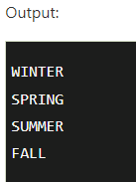
Simple Example of Java Enum
class EnumExample1{
//defining the enum inside the class
public enum Season { WINTER, SPRING, SUMMER, FALL }
//main method
public static void main(String[] args) {
//traversing the enum
for (Season s : Season.values())
System.out.println(s);
}}

Slide 7
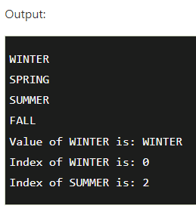
Let us see another example of Java enum where we are using value(), valueOf(), and ordinal() methods of Java enum.
class EnumExample1{
//defining enum within class
public enum Season { WINTER, SPRING, SUMMER, FALL }
//creating the main method
public static void main(String[] args) {
//printing all enum
for (Season s : Season.values()){
System.out.println(s);
}
System.out.println("Value of WINTER is: "+Season.valueOf("WINTER"));
System.out.println("Index of WINTER is: "+Season.valueOf("WINTER").ordinal());
System.out.println("Index of SUMMER is: "+Season.valueOf("SUMMER").ordinal());
}}

Slide 8
Purpose of value(), valueOf(), and ordinal() methods of Java enum.
The values() method returns an array containing all the values of the enum.
The valueOf() method returns the value of given constant enum.
The ordinal() method returns the index of the enum value.

Slide 9
Defining Java Enum
The enum can be defined within or outside the class because it is similar to a class.
The semicolon (;) at the end of the enum constants are optional.
For example:
enum Season { WINTER, SPRING, SUMMER, FALL }
Or,
enum Season { WINTER, SPRING, SUMMER, FALL; }
Both the definitions of Java enum are the same.

Slide 10
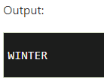
Java Enum Example: Defined outside class
enum Season { WINTER, SPRING, SUMMER, FALL } class EnumExample2{
public static void main(String[] args) {
Season s=Season.WINTER;
System.out.println(s);
}}

Slide 11
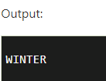
Java Enum Example: Defined inside class
class EnumExample3{
enum Season { WINTER, SPRING, SUMMER, FALL; }//semicolon(;) is optional here
public static void main(String[] args) {
Season s=Season.WINTER;//enum type is required to access WINTER
System.out.println(s);
}}

Slide 12
Initializing specific values to the enum constants
The enum constants have an initial value which starts from 0, 1, 2, 3, and so on.
But, we can initialize the specific value to the enum constants by defining fields and constructors.

Slide 13
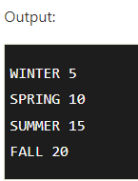
Example of specifying initial value to the enum constants
class EnumExample4{
enum Season{
WINTER(5), SPRING(10), SUMMER(15), FALL(20);
private int value;
private Season(int value){
this.value=value;
}
}
public static void main(String args[]){
for (Season s : Season.values())
System.out.println(s+" "+s.value);
}}

Slide 14
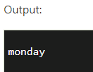
Java Enum in a switch statement
We can apply enum on switch statement as in the given example:
Example of applying Enum on a switch statement
class EnumExample5{
enum Day{ SUNDAY, MONDAY, TUESDAY, WEDNESDAY, THURSDAY, FRIDAY, SATURDAY}
public static void main(String args[]){
Day day=Day.MONDAY;
switch(day){
case SUNDAY:
System.out.println("sunday");
break;
case MONDAY:
System.out.println("monday");
break;
default:
System.out.println("other day");
}
}}

Slide 15



Thank You

